Slide 1
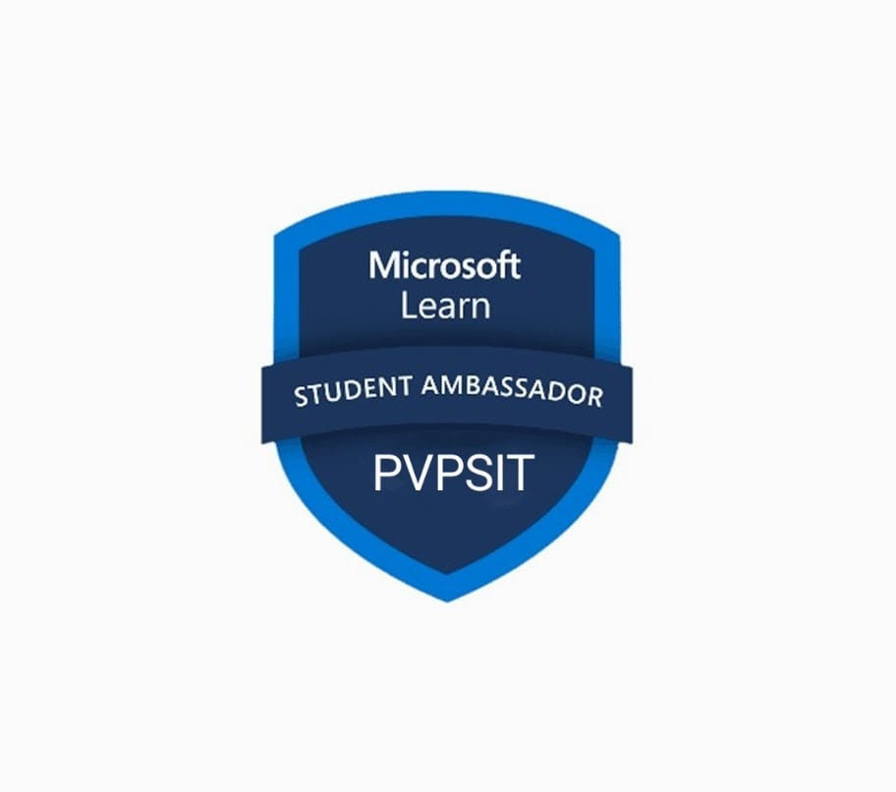
Microsoft Learn Student Community
Workshop on DevOps using Azure
PVPSIT CHAPTER

Slide 2
Our Mission and Vision
Mission
Creating a Supportive Community
Enhance technical skills through hands-on workshops
Focus on cutting-edge technologies and provide access to industry-standard tools and resources.
Vision
Inspire Passion for Technology
Encourage continuous learning.
Equip students with skills for a thriving career in the tech industry.

Slide 3
Workshop Overview
Objective
Focused on implementing DevOps practices using the Azure platform.

Slide 4
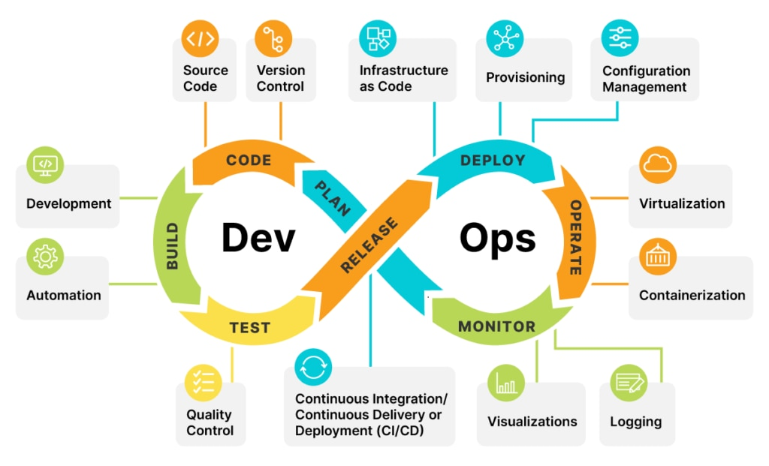
Key Initiatives
Workshop
DevOps Class: Enhancing Skills for Modern Software Development
Organized Microsoft DevOps Skills Challenges aimed at improving student understanding and application of DevOps methodologies, tools, and practices. Participants engaged in hands-on activities that fostered collaboration, continuous integration, and automation, preparing them for real-world software development scenarios.

Slide 5
Modules Overview
Module 1: Describe Cloud Service Types (12 min)
Module 2: Introduction to DevOps (42 min)
Module 3: Introduction to Azure DevOps (21 min)
Module 4: Discover DevOps (15 min)
Module 5: Develop with DevOps (52 min)
Module 6: Deliver with DevOps (57 min)
Module 7: Operate with DevOps (53 min)
Module 8: Integrate with Azure Pipelines (27 min)
Module 9: Introduction to Azure Cloud Shell

Slide 6
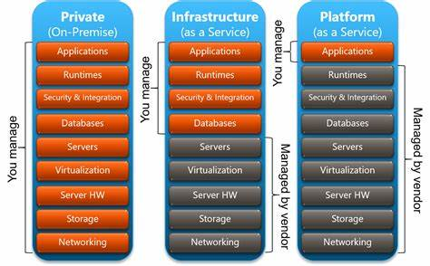
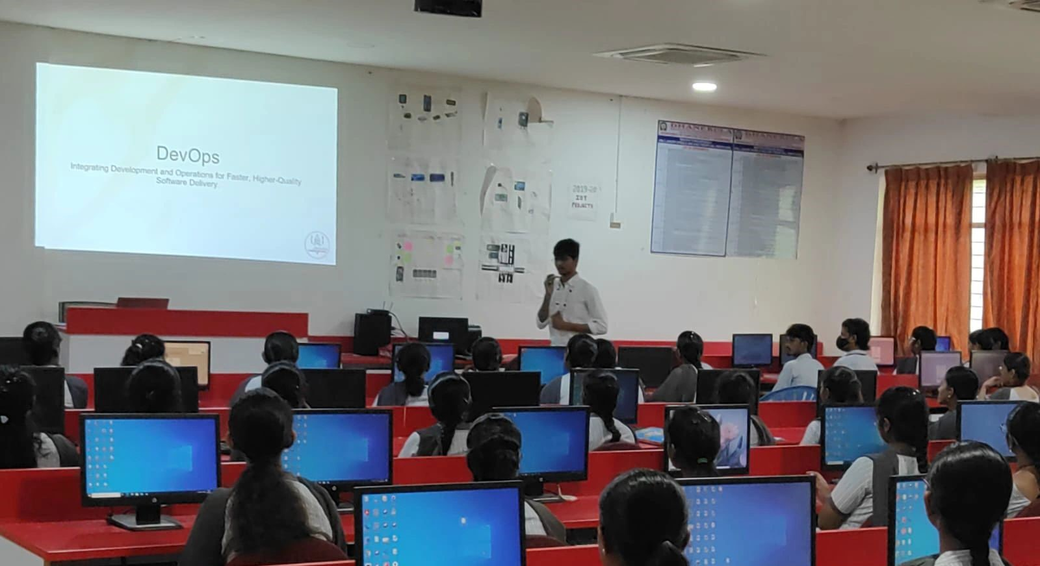
Highlights Glimpse :
IaaS (Infrastructure as a Service): Provides virtualized computing resources over the internet, allowing users to rent IT infrastructure on a pay-as-you-go basis.
PaaS (Platform as a Service):
Offers a platform allowing developers to build, deploy, and manage applications without the complexity of managing the underlying infrastructure.
SaaS (Software as a Service):
Delivers software applications over the internet on a subscription basis, eliminating the need for installation and maintenance.
Introduction to DevOps :
A set of practices that combines software development (Dev) and IT operations (Ops) to shorten the development lifecycle and deliver high-quality software more efficiently.

Slide 7
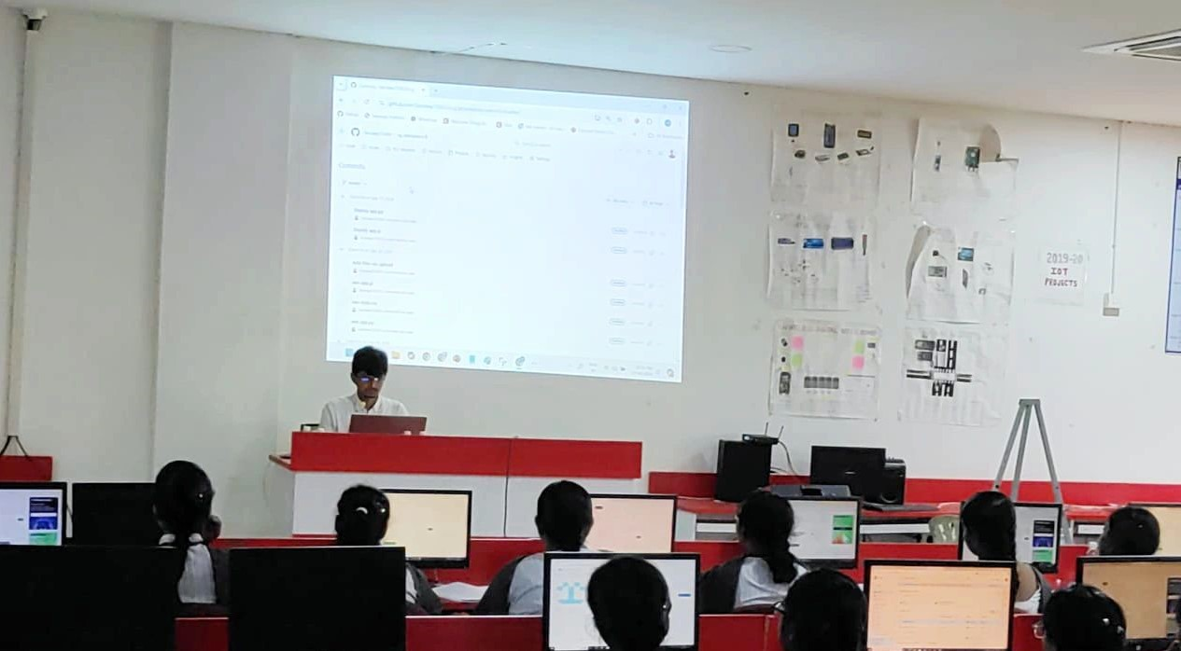
Module 1: Describe Cloud Service Types (12 min): Overview of cloud computing service models including IaaS, PaaS, and SaaS, highlighting their characteristics and use cases.
Module 2: Introduction to DevOps (42 min): Introduction to the principles and practices of DevOps, focusing on collaboration, automation, and continuous improvement in software development.
Modules Overview
Module 3: Introduction to Azure DevOps (21 min): An overview of Azure DevOps services that support the entire software development lifecycle, enabling teams to plan, develop, and deliver software efficiently.
Module 4: Discover DevOps (15 min): Exploration of DevOps culture and methodologies, emphasizing the importance of collaboration between development and operations teams.

Slide 8
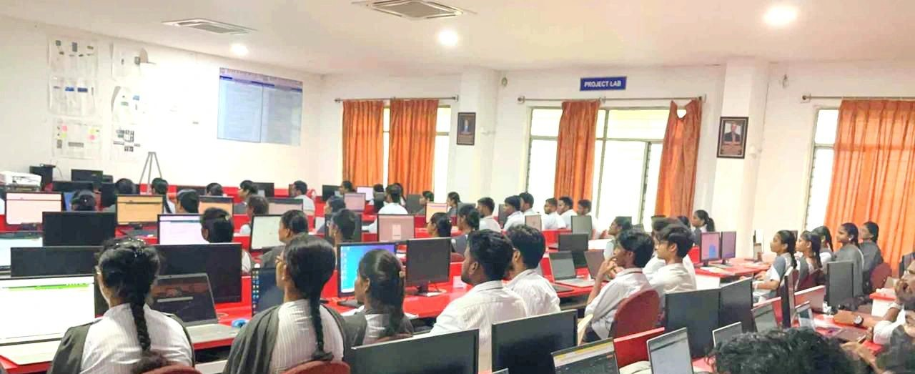
Module 5: Develop with DevOps (52 min): Best practices for software development within a DevOps framework, including coding standards, version control, and collaboration tools.
Module 6: Deliver with DevOps (57 min): Strategies for continuous delivery and deployment in DevOps, focusing on automation, testing, and monitoring to enhance software release cycles.
Module 7: Operate with DevOps (53 min): Techniques for managing and maintaining applications in production, including incident management, monitoring, and performance optimization.
Module 9: Introduction to Azure Cloud Shell: A browser-based shell experience that enables users to manage Azure resources using command-line tools and scripts without local setup.
Module 8: Integrate with Azure Pipelines (27 min): Introduction to Azure Pipelines, a CI/CD service that automates the building, testing, and deployment of applications across multiple environments.

Slide 9
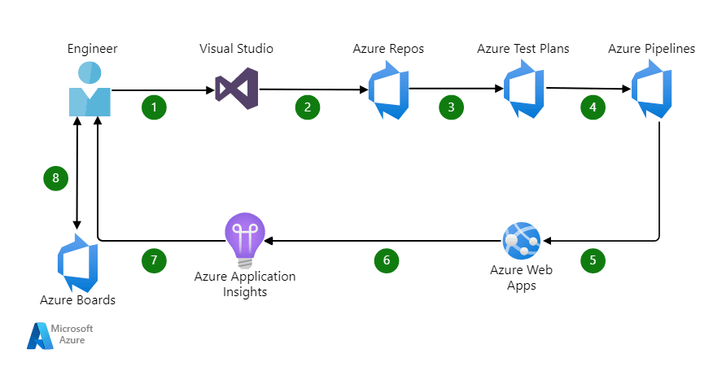
Continuous Integration: The practice of automating code integration to development process detect and address issues early in the.
Automation: Streamlining deployment processes to reduce manual intervention and increase efficiency in software delivery.
Collaboration: Enhancing communication and teamwork between development and operations teams to foster a shared understanding of goals and challenges.

Slide 10
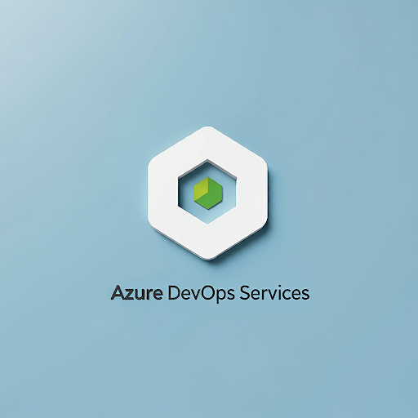
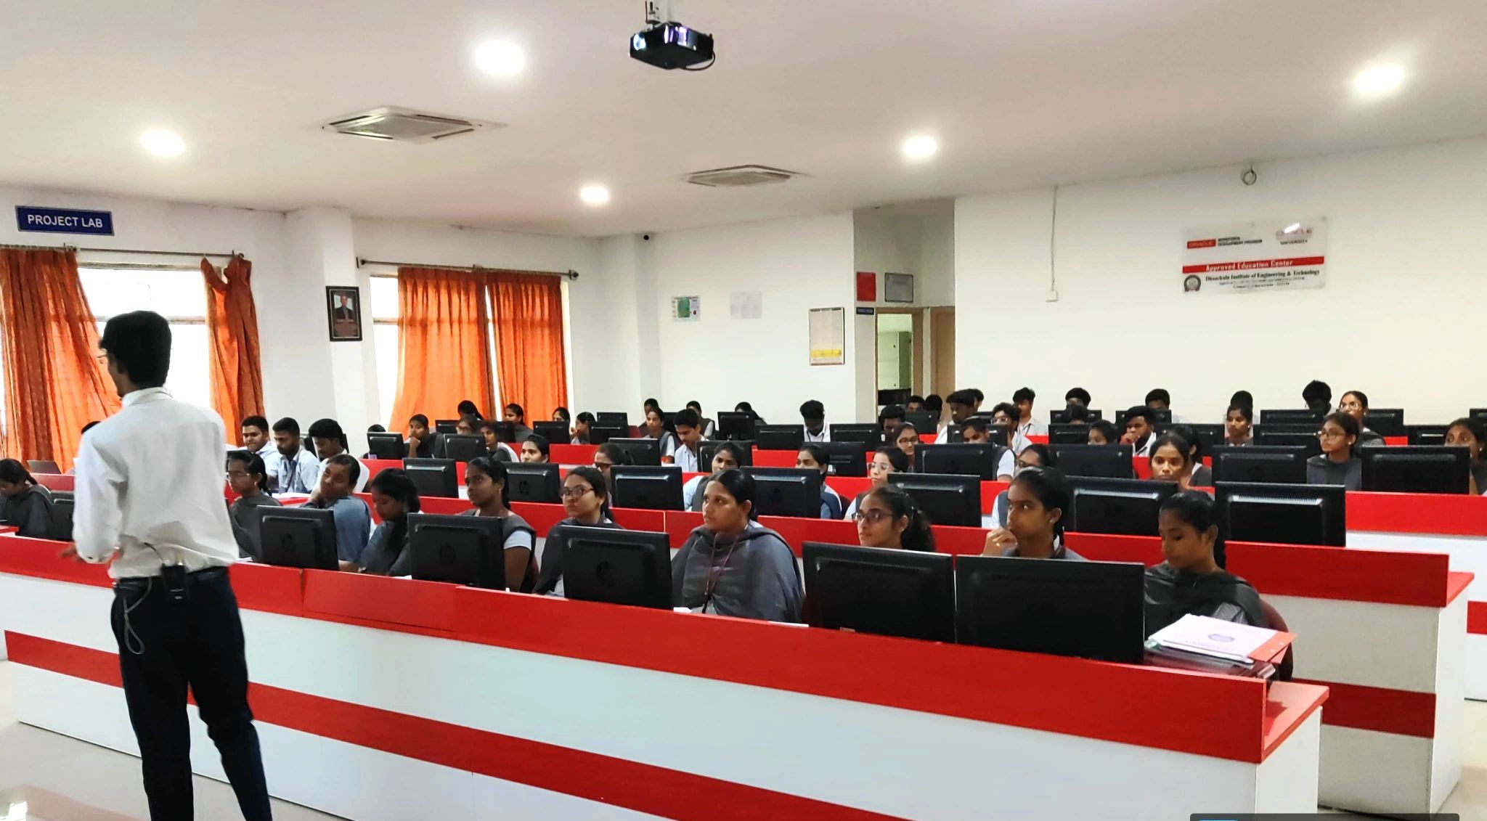
Azure DevOps Services: Practical applications and features of Azure DevOps learned during the workshop, enabling effective project management and collaboration.
Real-World Scenarios: Attendees engaged with hands-on projects that simulate actual challenges faced in software development and deployment.

Slide 11
Conclusion
Key Take aways: Participants gained an enhanced understanding of DevOps methodologies and Azure tools essential for modern software development.
Implementation Skills: Attendees developed the skills necessary to effectively implement DevOps practices within their organizations.

Slide 12


Meet The Team
Chakka Vijay Chandra
Chairperson
PVPSIT
Back to Agenda

Slide 13


Faculty Coordinator
Ravi Prakash Paruchuri
Assistant Professor, IT.

Slide 14


Connect with us.
Email
ChakkaVijay.Chandra@studentambassadors.com
LinkedIn
Chakka Vijay Chandra

Slide 15
Any Questions ??
Feel Free To Ask Us....

Slide 16
Thank you

